Slide 1

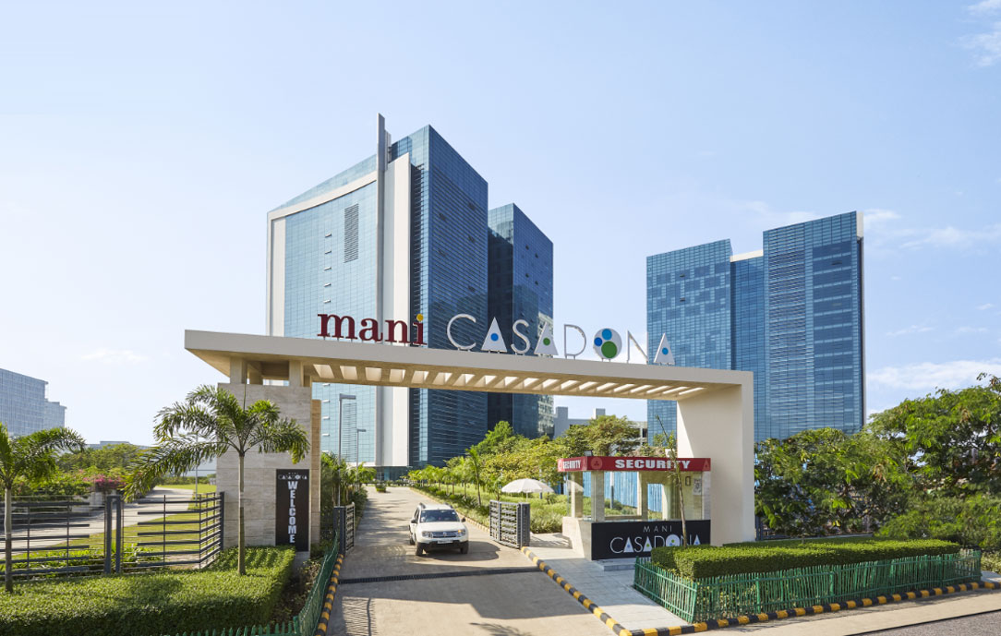

KOLKATA DC HACKATHON
TANSAKU – Multimodal Search and Product Discovery
By team base234

Slide 2

PROBLEM STATEMENT
In the era of online shopping and e-commerce, enhancing user experience and enabling efficient product discovery are critical for businesses. Text-based queries can be ambiguous, leading to results that don't match the user's intent.
Some queries might be complex and hard to express accurately in text, especially for intricate or specialized products. Products with specific visual characteristics might be challenging to describe accurately in text, leading to potentially inaccurate results.
The challenge lies in creating a robust and effective system that can accurately understand and process user-uploaded images to retrieve relevant products from a vast catalog.

Slide 3
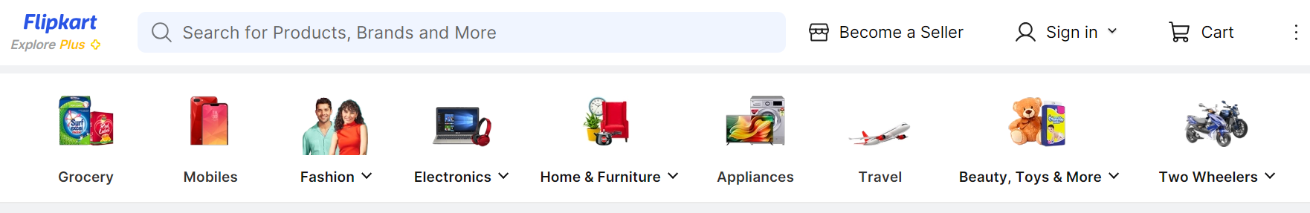
EXISTING ECOSYSTEMS
** Popular e-commerce websites restricted to text search only.

Slide 4


SOLUTION
The goal of this project is to develop a generative AI system that revolutionizes the way customers interact with e-commerce platforms by introducing multimodal search capabilities leveraging state-of-the-art LLM technologies.
This system will allow users to upload images of desired products or items, and it will then identify similar products from the product catalog, enhancing the user's shopping experience.
We develop generative AI system that enable visual search, allowing customers to find products by uploading images rather than using text-based queries.

Slide 5
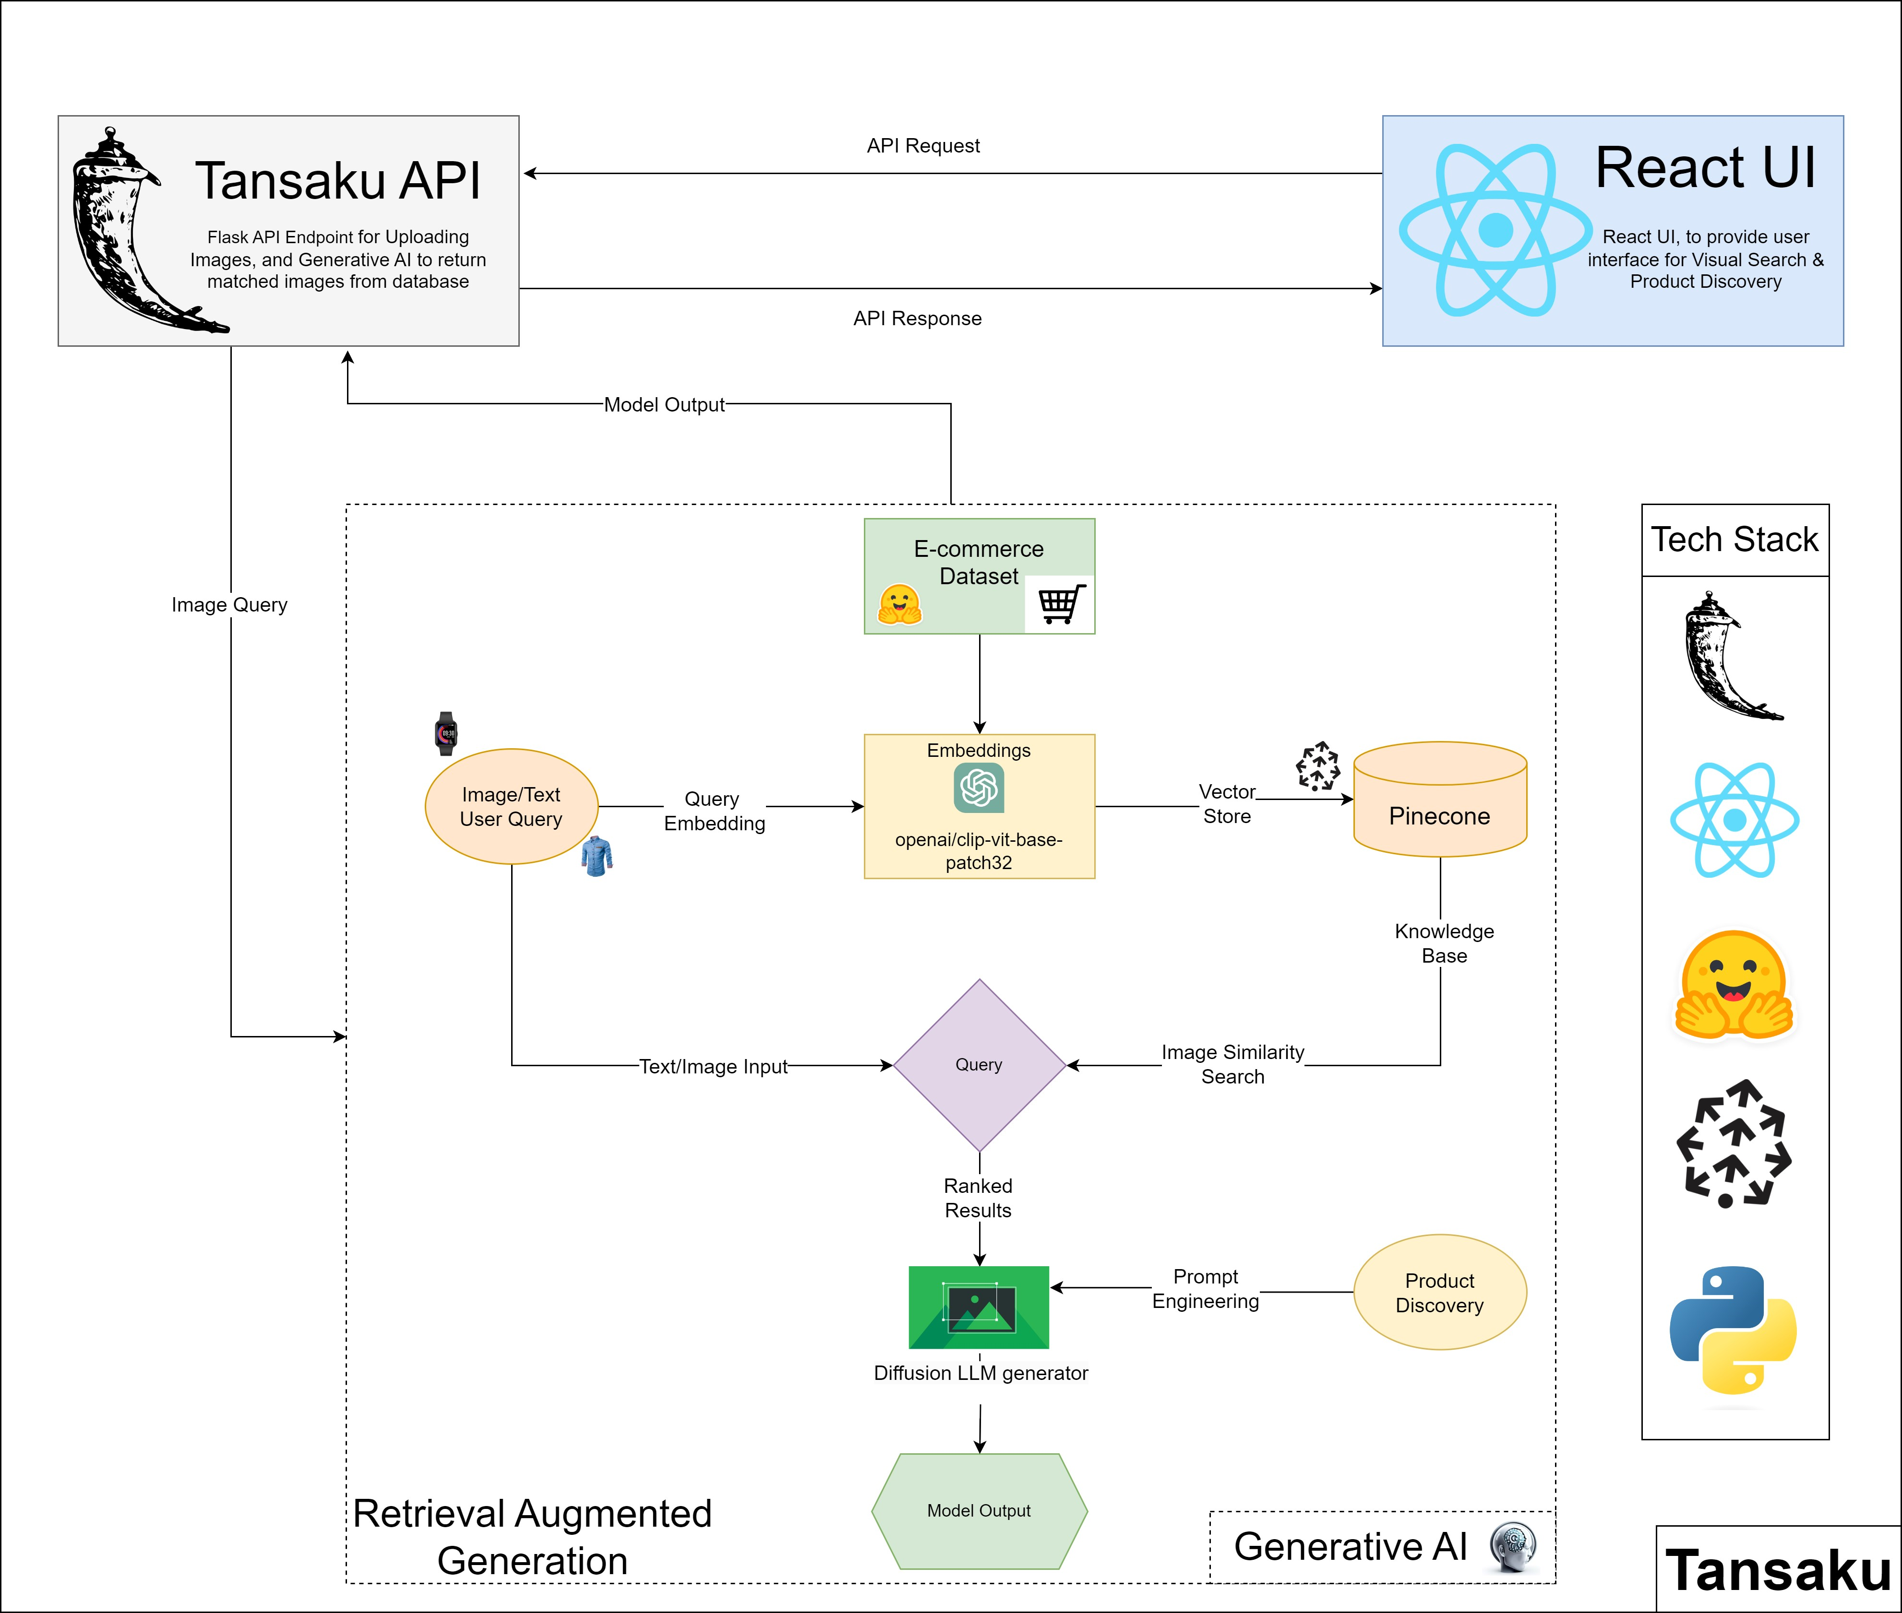
ARCHITECTURE DIAGRAM

Slide 6
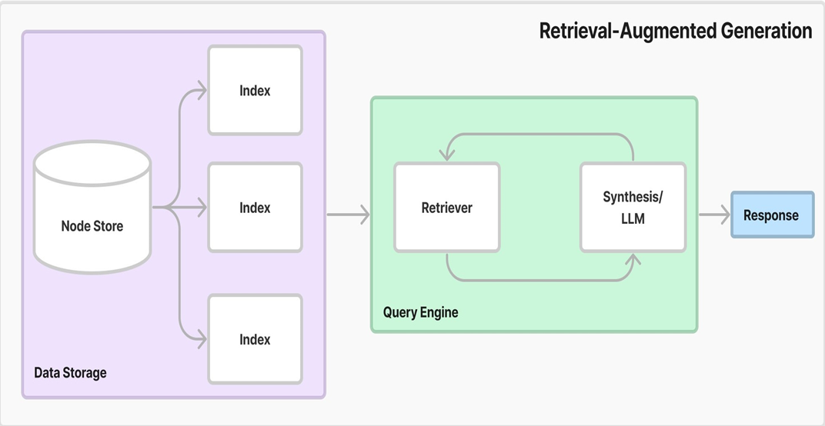
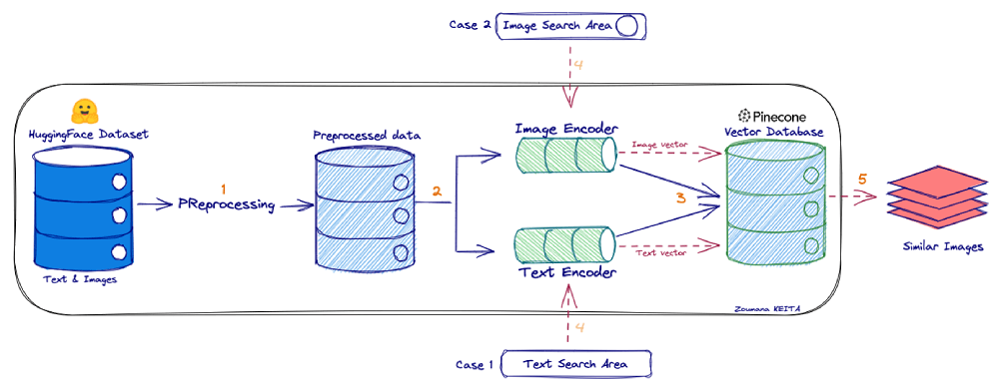
OUR APPROACH
For visual search, we’ve encoded query images using the trained encoder and then find similar encoded representations from our dataset.
OpenAI's CLIP (Contrastive Language-Image Pretraining) model is used for embedding images.
Each of these embeddings are then saved to Pinecone Vector Database for semantic search against query.
For product discovery, we generate new product images using the trained generator and display them to users based on their preferences.

Slide 7
DEMO

Slide 8
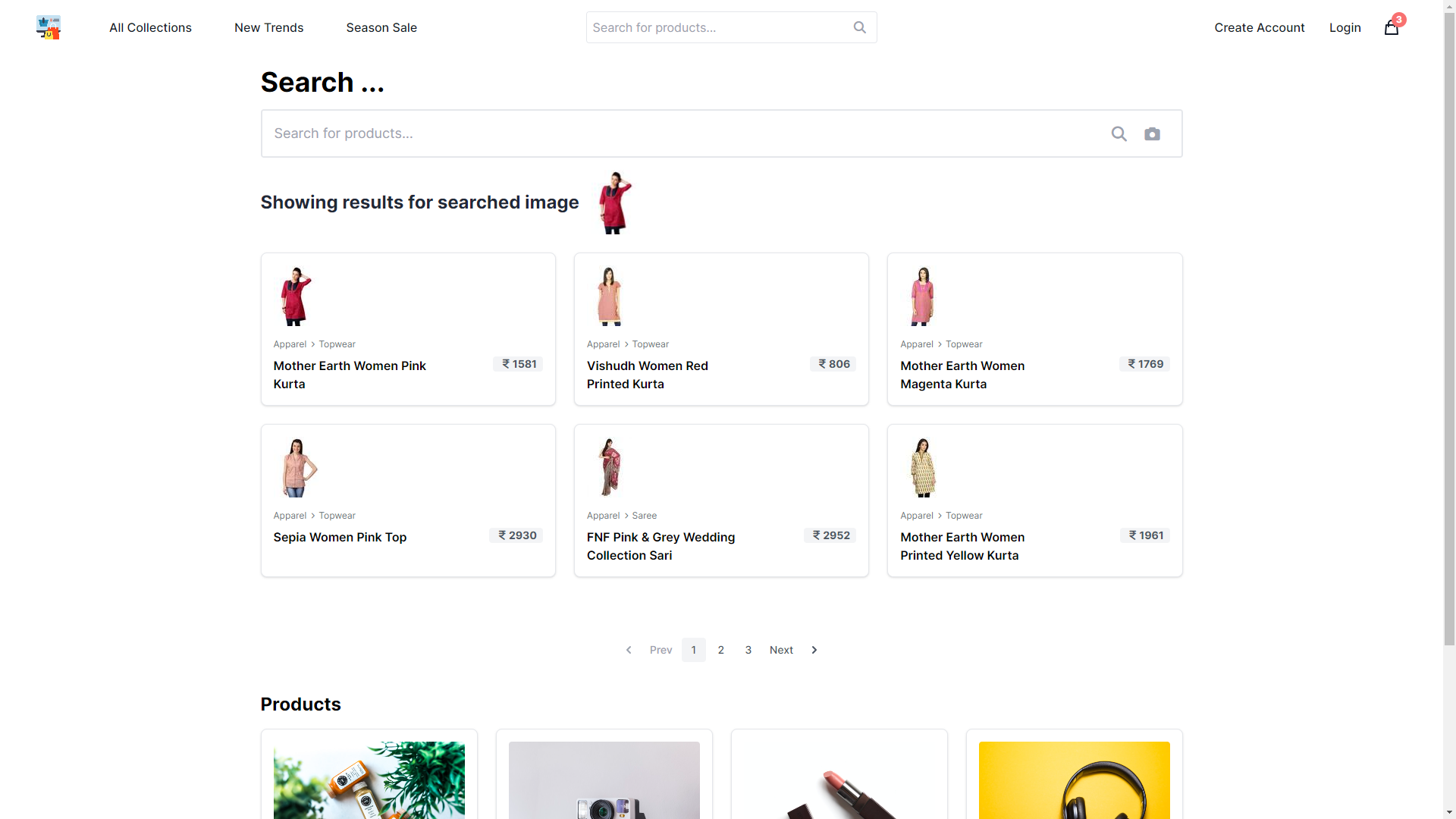
Application Screenshots

Slide 9

Future Scope
Image to Image Search.
Text to Image Search.
Product Discovery (Create new types of products based on user requirements).
Use generative AI to extract results from multiple E-commerce databases.
Create an Android/iOS Application.
Deploy the Application in AWS using EKS (Elastic Kubernetes Service)

Slide 10

Resources
45%
10%
35%
10%
YouTube
Video
-

Slide 11
Thank You

